Slide 1
Auction Design

Slide 2
Background
Last time: In a benchmark model with “symmetric” bidders we saw that if bidders play according to Nash equilibrium, then several common auction designs
  Result in an efficient allocation: high value bidder wins.
  Result in same expected revenue: equal to the expected second highest value.
Today: think more about auction design
  Strategies to increase revenue: reserve prices
  Strategies to favor certain bidders: subsidies.
  Practical concerns: entry and collusion.

Slide 3
Reserve prices
Two bidders, with values v₁ and v₂
Each v_{i} drawn from uniform distribution on [0,100].
Last time we showed the expected revenue was 33.
Can the seller benefit from setting a “reserve” price, i.e. a minimum price below which she won’t sell?

Slide 4
Reserve prices, cont.
Seller sets reserve price r
Runs an ascending auction
  Clock starts from r and goes up, and bidders may choose not to be active at the beginning if they have low values.
Three cases
  Both bidder values below r ⇒ no sale.
  One value above r, one below r ⇒ sale at r.
  Both values above r ⇒ sale at lower value.

Slide 5
Revenue with reserve price
Expected revenue (add up three cases & probabilities)
Event | Probability | Exp. Revenue
v₁, v₂ < r | r × r | 0
v_{i} < r < v_{j} | 2× r × (1-r) | r
v₁, v₂ > r | (1-r) × (1-r) | r + (1/3)(1-r)
Expected revenue = 0 + 2r²(1-r) + (1-r)²[1/3 + (2/3)r]
To maximize, set d(Exp Rev)/dr = 0
  0= 4r - 6r² - 2(1-r)(1/3+(2/3)r) + (2/3)(1-r)² = 2r - 2r²

Slide 6
Optimal Reserve Price

Slide 7
Optimal Reserve with N=2,3

Slide 8
Reserve price & competition
 | No Reserve (r=0) |  | Optimal Reserve (r=0.5)
N | Pr(Sale) | E[Rev] | Pr(Sale) | E[Rev]
1 | 1 | 0 | 0.50 | 25
2 | 1 | 33 | 0.75 | 42
3 | 1 | 50 | 0.88 | 53
4 | 1 | 60 | 0.95 | 61
5 | 1 | 67 | 0.97 | 67
Optimal reserve price is r=50 independent of number of bidders N (assuming all draw values from U[0,100]) - try it!

Slide 9
Evidence on reserve prices
We’ve seen how reserve prices work in theory but what about in practice. Does it help to set a higher reserve?
Seems as if it might be hard to test
  At a used car auction, the bmws will have higher reserve prices than the chevys, but are also worth more.
  Best evidence would be experimental - sell multiple versions of the same thing with different reserve prices.
Let’s see if we can find some examples on eBay.

Slide 10
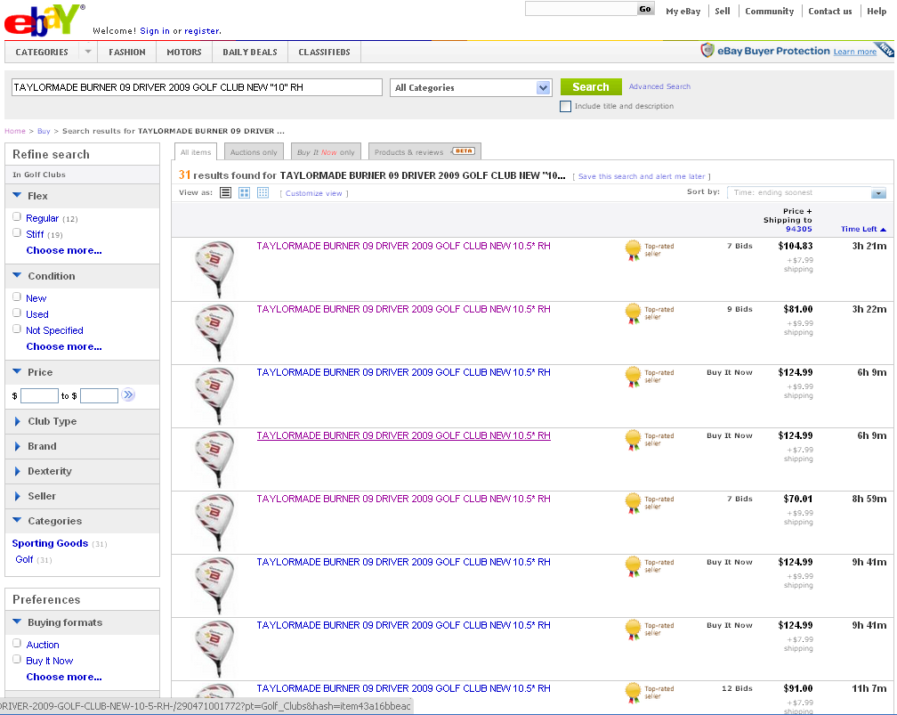
An eBay “experiment”

Slide 11
Effect of reserve on Pr(Sale)
From Einav, Kuchler, Levin, and Sundaresan (2012) “Seller Experiments”

Slide 12
Effect of reserve on price

Slide 13
Optimal reserve prices
On eBay, the profit-maximizing reserve prices appear to be
  Very low reserve price: maximizes probability of sale and relies on competition to protect against low price outcome of auction.
  Or
  Very high reserve price: (close to item’s posted price) low chance of sale, but seller is guaranteed a good price if auction succeeds.
In practice, sellers mostly use very low ($0.99) reserve prices or high reserve prices that effectively work as posted prices.

Slide 14
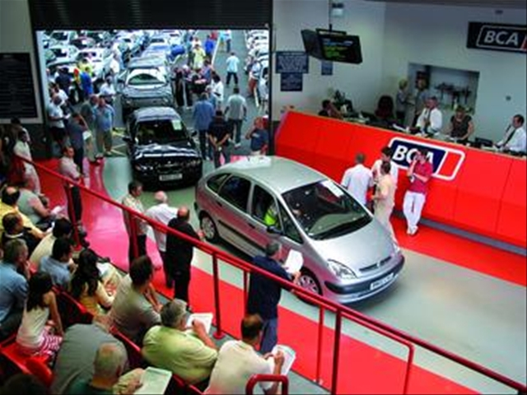
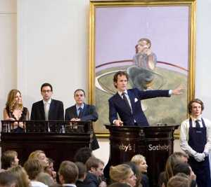
Secret Reserve Prices?
In many auctions, reserve prices are not announced in advance. Instead, the seller decides at the end if she wants to sell at the final auction price. Why might this be?

Slide 15
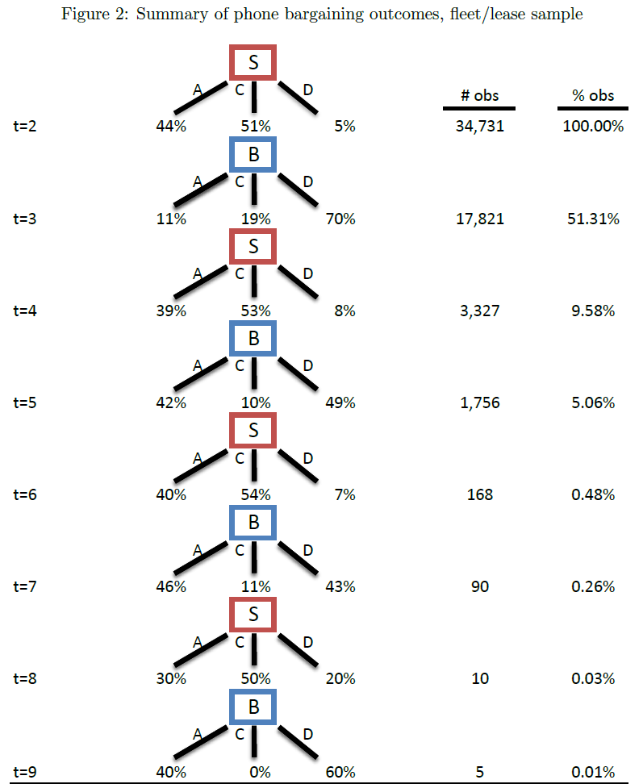
Used Car Auctions
Live Car Auction
From Larsen (2014) “The Efficiency of Dynamic, Post-Auction Bargaining: Evidence from Wholesale Used-Auto Auctions”

Slide 16
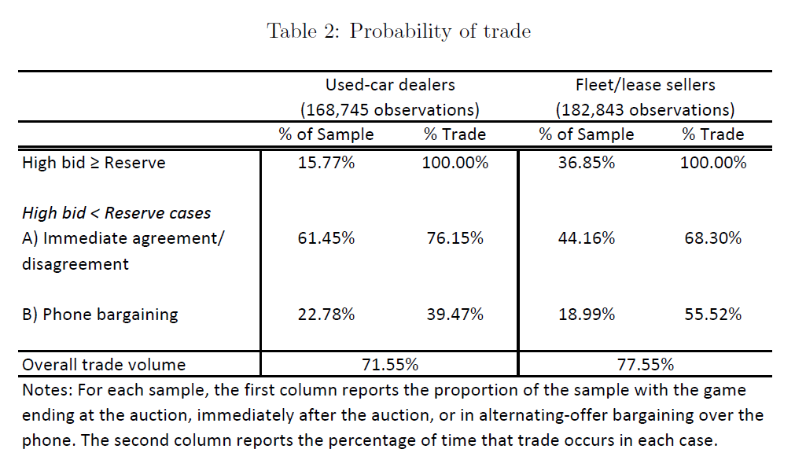
Used Car Auctions
Larsen estimates that the secret reserve + negotiation mechanism is highly efficient!

Slide 17
Bidder Subsidies + Set-Asides
In real-world auctions, it is common to see sellers choose to treat some bidders preferentially. Why?
  For distributional reasons: e.g. state and federal procurement explicitly favors domestic, small or minority-owned businesses by restricting entry or giving subsidies.
  For competition reasons: to “level” the playing field, or encourage entry and create competition as in the case of attracting a “white knight” to a takeover battle.

Slide 18
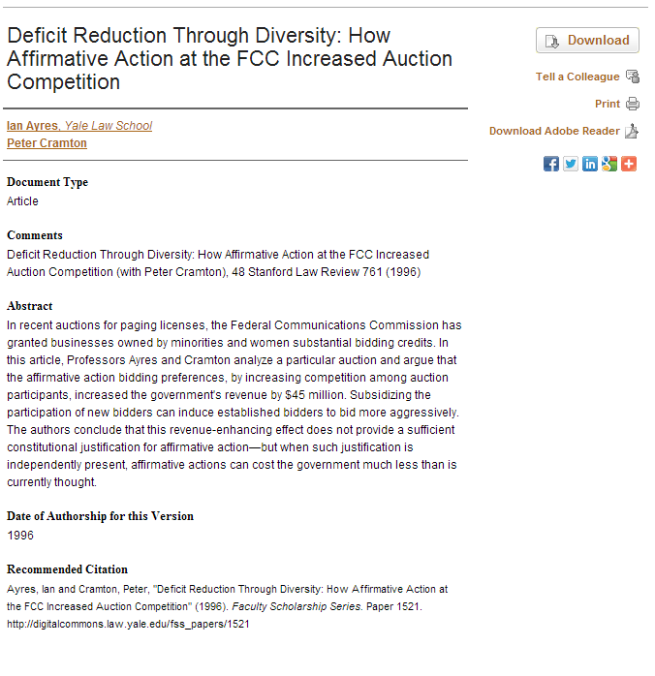
Raising Revenue at the FCC
Ian Ayres and Peter Cramton have argued that the FCC’s policy of subsidizing minority-owned firms raised revenue when the FCC started selling spectrum licenses in the 1990s.
How? These firms pushed the large bidders to bid higher, raising the final auction prices.

Slide 19
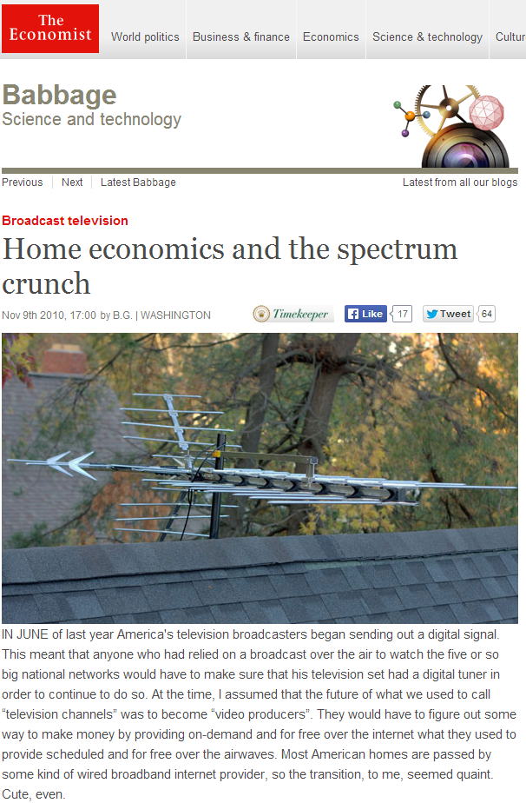
FCC & Competition Policy
Now, FCC is designing a new “incentive auction” to buy up the licenses of broadcast television companies, and create new licenses for wireless carriers to offer mobile broadband services.
This is an attempt to address the so-called “spectrum crunch” facing mobile carriers.

Slide 20
FCC & Competition Policy
Incentive auction objectives
  Get good prices for the wireless licenses – in fact this is going to be necessary to pay the broadcasters!
  Ensure that there is a competitive telecom industry after the auction.
Likely bidders include AT&T, Verizon, T-Mobile, Sprint, as well as smaller phone carriers.
  AT&T and Verizon are the “big two”. They own almost all of the best spectrum below 1000 MHz. This new auction will be some of the last spectrum of that type to be allocated.

Slide 21
FCC & Competition Policy
Suppose the FCC plans to allocate 7 national licenses and bidders want to buy multiple licenses.
How to ensure that there are more than two major players in the industry after the auction?
  Give “smaller” carriers an x% discount?
  Restrict each carrier to no more than x licenses?
  Restrict largest carriers to x licenses in total?
Problem: how to choose x in each case!
Set-asides provide more certainty about who wins, but might end up with lower revenue. A tricky problem…

Slide 22
“Optimal” auction design
We’ve identified two ways to raise more revenue
  Reserve prices: withhold “quantity” to get a higher price.
  Subsidies: favor weak bidder to get more competition.
General analysis of “optimal” or “revenue-maximizing” auctions (for which Myerson won 2007 Nobel Prize):
  Ascending auctions are efficient (high value bidder wins), but
  Sellers generally can benefit from distorting an auction away from efficiency in order to realize higher revenue (just like any monopolist!)

Slide 23
Optimal subsidies
Ascending auction with a
6% small bidder subsidy
“Big” bidder wins
From Athey, Coey, Levin (2013). Optimal auction estimated from US Forest Service timber auction data

Slide 24
Practical Issues
Our analysis has assumed
  A fixed set of bidders willing to participate
  Bidders behave competitively, or “non-cooperatively”
Practical auction design has to worry about
  Collusion - bidders may cooperate not compete
  Entry - can be hard to get bidders to participate

Slide 25
Collusion
Collusion occurs if bidders agree in advance or during the auction to let prices settle at a low level.
  This is generally illegal, but it can and does happen.
Concern is often biggest (and can be less obviously illegal) when there are multiple items for sale: e.g. “you take these, I’ll take these – let’s end the auction”.
With a single item – collusion might rely on
  Side agreements: you win today, and share the profit with me.
  Intertemporal trades: you win today, I’ll win tomorrow

Slide 26
Collusion: Example
U.S. v. Pook (1988): Bidding ring that operated at antique auctions.
When a dealer pool was in operation at a public auction of consigned antiques, those dealers who wished to participate in the pool would agree not to bid against the other members of the pool. If a pool member succeeded in purchasing an item at the public auction, pool members interested in that item could bid on it by secret ballot at a subsequent private auction (“knock out”) .... The pool member bidding the highest at the private auction claimed the item by paying each pool member bidding a share of the difference between the public auction price and the successful private bid. The amount paid to each pool member (“pool split”) was calculated according to the amount the pool member bid in the knock out.
Court decision quoted in Kovacic, Marshall, Marx and Raiff (2005)

Slide 27
Collusion: Example
The ring used an internal auction or ‘knockout’ to coordinate bidding. Ring members would send a fax or supply a written bid to an agent (a New York taxi and limousine driver employed by the ring), indicating the lots in which they were interested, and what they were willing to bid for them in the knockout auction. The taxi driver would then collate all the bids, determine the winner of each lot, notify the ring as to the winners in the knockout and send the bids to another ring member who would coordinate the side payments after the target auction was concluded. Depending on who actually won the knockout, the taxi driver would, usually, either bid for the winner in the target auction, using the bid supplied in that auction as the upper limit, or organize for another auction agent to bid for the winner on the same basis. In the language of auction theory, the knockout was conducted using a sealed-bid format, with the winning bidder getting the right to own the lot should it be won by the ring in the target auction. The winning bid in the knockout set the stopping point for the ring’s bidding in the target auction. Since bidding in the target auction was handled by the ring’s agent, monitoring compliance with this policy was not a problem.
Description of stamp bidding ring, from Asker (2010, AER)

Slide 28
The Stamp Ring Mechanism
Bidders submit their offers to the ring auctioneer.
High bidder, and high bidder only, enters main auction at his bid.
If ring bidder wins, payments within the ring computed as follows
  First, subtract main auction payment from all ring bids.
  Throw away negative (net) bids that would have lost main auction.
  Bidders who made positive bids get to share in the ring gains.
  Look at “increment” from auction price up to first ring bid – divide among all ring participants (could be equal, or 50% to winner and then equal).
  Then look at next “increment” and divide between all ring bidders who bid higher, and so forth.
  Winner makes side payments to losers so gains are split accordingly.
Let’s look at an example.

Slide 29
The Stamp Ring Mechanism
Bidder | Knockout Bid | Bid net of Main Auction Price | Private Side Payment
A | 400 | 400 - 200 = 200 | Pay 75
B | 350 | 350 - 200 = 150 | Get 50
C | 300 | 300 - 200 = 100 | Get 25
D | 185 | 185 - 200 = -15 | 0
Payment to Main Auction | 200
First increment of 100, split between A, B, C (1/2 to winner)
Second increment of 50 split between A,B.
Last increment of 50 goes to A.

Slide 30
Deterring Collusion
What auction design works to deter collusion?
Ascending:
  Suppose bidders A and B agree in advance that A should win at a low price. Although B can deviate from the agreement and keep bidding, A can just bid back - helps enforce the agreement.
Sealed bidding
  If A and B agree that A should win at a low price, A must submit a low bid. But then B can send in a slightly higher bid and win the auction at a low price. Makes it harder to sustain collusion.

Slide 31
Entry
A typical problem in organizing auction sales is to make sure that enough bidders will participate
Auctions rely on having competition to set the price, and bidders may not want to participate unless they think they have a good chance.
When might entry be a concern, and what can be done?

Slide 32
Entry example
Two bidders, values drawn from U[0,100] and U[0,200].
Bidder expected profits from ascending auction
  Bidder 1 expects to win with probability 1/4. When he does win, he expects to have a value of 66 and to pay 33. So his overall expected profit if he participates is 8.3
  Bidder 2 expects with probability ½ to have a value above 100, and in this case make 150-50=100, or a value below 100, in which case he expects to make (1/2)*(66-33)=16.6. So his overall expected profit is 58.3
If the cost of entry is 10, Bidder 1 won’t even bother.
And Bidder 2 could end up winning at a price of zero!

Slide 33
Auction design to promote entry
Subsidize weaker bidders
  Encourages their participation - can also restrict very strong bidders from entering (a “set-aside” policy)
Subsidize entry costs directly
  E.g. in architectural competitions, architects partly reimbursed for building a model needed to submit a bid for the contract.
Sealed bidding: (?)
  Prospect of very low prices in sealed bid auction encourages bidders to enter and try to “steal” the auction - whereas with open bidding, a strong bidder can respond.

Slide 34
Summary
Auction design can involve multiple objectives
  Efficiency: making sure high value bidder wins
  Revenue: getting the best possible return on the sale
  Distributional: ensuring that certain bidders have a chance.
There are often trade-offs between these objectives
  Reserve prices and subsidies can sometimes increase revenue even though they may distort the auction away from efficiency.
Practical auction design also has to worry about basic economic issues such as collusion and entry.

Slide 35
Extra Slides

Slide 36
Bid Subsidies
Two bidders, values v₁ and v₂
Bidder 1 draws v₁ from uniform on [0,100].
Bidder 2 draws v₂ from uniform on [0,200].
What will happen in an ascending auction?
  Both bidders will bid up to their values and the high value bidder will win - more likely to be Bidder 2 than Bidder 1.

Slide 37
Solving for the expected price
There are two possible and equally likely cases
  Bidder 2’value is greater than 100. Then Bidder 2 wins for sure and pays Bidder 1’s value, which in expectation is 50.
  Bidder 2’s value is less than 100. Then Bidders 1 and 2 both have values U[0,100], so they are equally likely to win and the expected price is 33.
So Bidder 2 wins with probability 3/4, Bidder 1 wins with probability 1/4, and the overall expected price is 41.6.

Slide 38
Bid Subsidies
Suppose seller gives 50% discount to the weaker bidder:
  e.g. if weak bidder wins at a price of 50, only has to pay 25.
What is the optimal weak bidder strategy?
Bid up to 2v₁ (at which point “price” is really v₁)
If watching the bidding, it will be “as if” both bidders have values drawn on [0,200], rather than [0,100] and [0,200].

Slide 39
Effect of the subsidy
Bidders are equally likely to win.
Expected “clock price” at end of auction is 66.
  Why? Expectation of lower of two draws from uniform [0,200].
Expected revenue is lower, however, equal to 50.
  Why? If bidder 1 wins, seller gets only half the price, so expected revenue is equal to ½*66 + ½*33 = 50.

Slide 40
Effect of subsidies
With no subsidy
  Strong and weak bidder win with probability 3/4, 1/4.
  Seller gets expected revenue of 41.6.
  Auction is efficient: high value bidder wins.
With subsidy for weak bidder
  Strong and weak bidder win with probability ½, ½.
  Seller gets expected revenue of 50. (Higher!)
  Auction is inefficient: weak bidder may win with lower value!

